Slide 1
October Meeting
Advisory Group

Slide 2
Agenda
Welcome
Advisory Group Member Expectations
Review of 2023 – 28 Strategic Plan
Breakout Rooms
Next Steps

Slide 3
AG Member Expectations

Slide 4
Advisory Group
Meet quarterly (virtually)
Complete the annual plan of work
For 2023 - 2024
Strategic Plan
Membership
Code of Conduct
OSH Trends
Cascade information to your constituents
Review Advisory Group website regularly for updates and summaries of meetings
Notes:
The Advisory Group, as directed by the bylaws, will meet at least quarterly throughout the program year. Additional meetings will be called if needed. All meetings are virtual.
The Annual Plan of work for 23-24 is
Communicating with and engaging members to advance the strategic plan. You will also help support communicating the new plan to membership. We will be reviewing that at today’s meeting.
Promoting the value of membership in ASSP, focusing on concluding the membership value project – Spring 2024
Empowering members to hold themselves accountable to the ASSP Code of Conduct (will be reviewed in December)
Continuing to monitor and bring to the Board’s attend OSH trends that ASSP members are experiencing
Make sure you are taking the information discussed and presented at these meetings to your constituents – your chapters, councils, regions, areas, practice specialties, common interest groups and your fellow safety colleagues. Information from all our meetings and summaries from breakout rooms are available on the Advisory Group webpage (assp.org Click on About and then ASSP Advisory Group on left hand tool bar).

Slide 5
Overview of 2023-28 Strategic Plan

Slide 6
Our 2023-28 Strategic Plan
Road map to achieving continued excellence, with all members contributing toward mission, vision and values.
Board of Directors allocates resources and provides oversight.
Professional staff, led by CEO, manages resources through strategies and tactics anchored in research.
Notes:
Our 2023-28 strategic plan provides a road map that will help us achieve continued excellence. All members contribute to helping us achieve our mission, advance our vision, demonstrate our values and accomplish the key goals identified in our plan.
The Board of Directors allocates resources and provides oversight, while the professional staff, led by our CEO, manages those resources, and uses member, market and trend research to identify and execute tactics to achieve our strategic goals and maintain our strong position in the marketplace.
Our strategic plan isn't a static document; it will evolve as we learn from our experiences and gather insights.
This ongoing learning process ensures we remain responsive to changes and pivot our approach as needed.
Demonstrated in practice throughout the pandemic.
Reinforces why creating agility through governance change was a crucial business decision.

Slide 7
Our Mission and Vision
MISSION
We are the community that protects people, property and the environment.
VISION
Safety, health and well-being are inherent rights of every worker.
Notes:
Mission
Reflects our role as the guardians of workplace safety in various domains.
Encourages growth and advancement of OSH professionals at any stage of their career.
Referring to ourselves as a community amplifies our belief that workplace safety is a collective effort that involves all stakeholders working together to eliminate hazards and reduce risks.
Vision
Reflects the future we wish to support by fulfilling our mission each day. Ideal to which we aspire, recognizing that this work requires collaboration with regulatory bodies, businesses and nongovernmental organizations as well as our community.
Echoes and builds on the rights outlined in the Occupational Safety and Health Act of 1970 by envisioning workplaces that go beyond general duty to assess and mitigate risks and keep safety, health and well-being at the center of business decisions.
In keeping with our commitment to DEI, we imagine a future in which the location and manner of work a person performs does not dictate their safety and health outcomes.

Slide 8
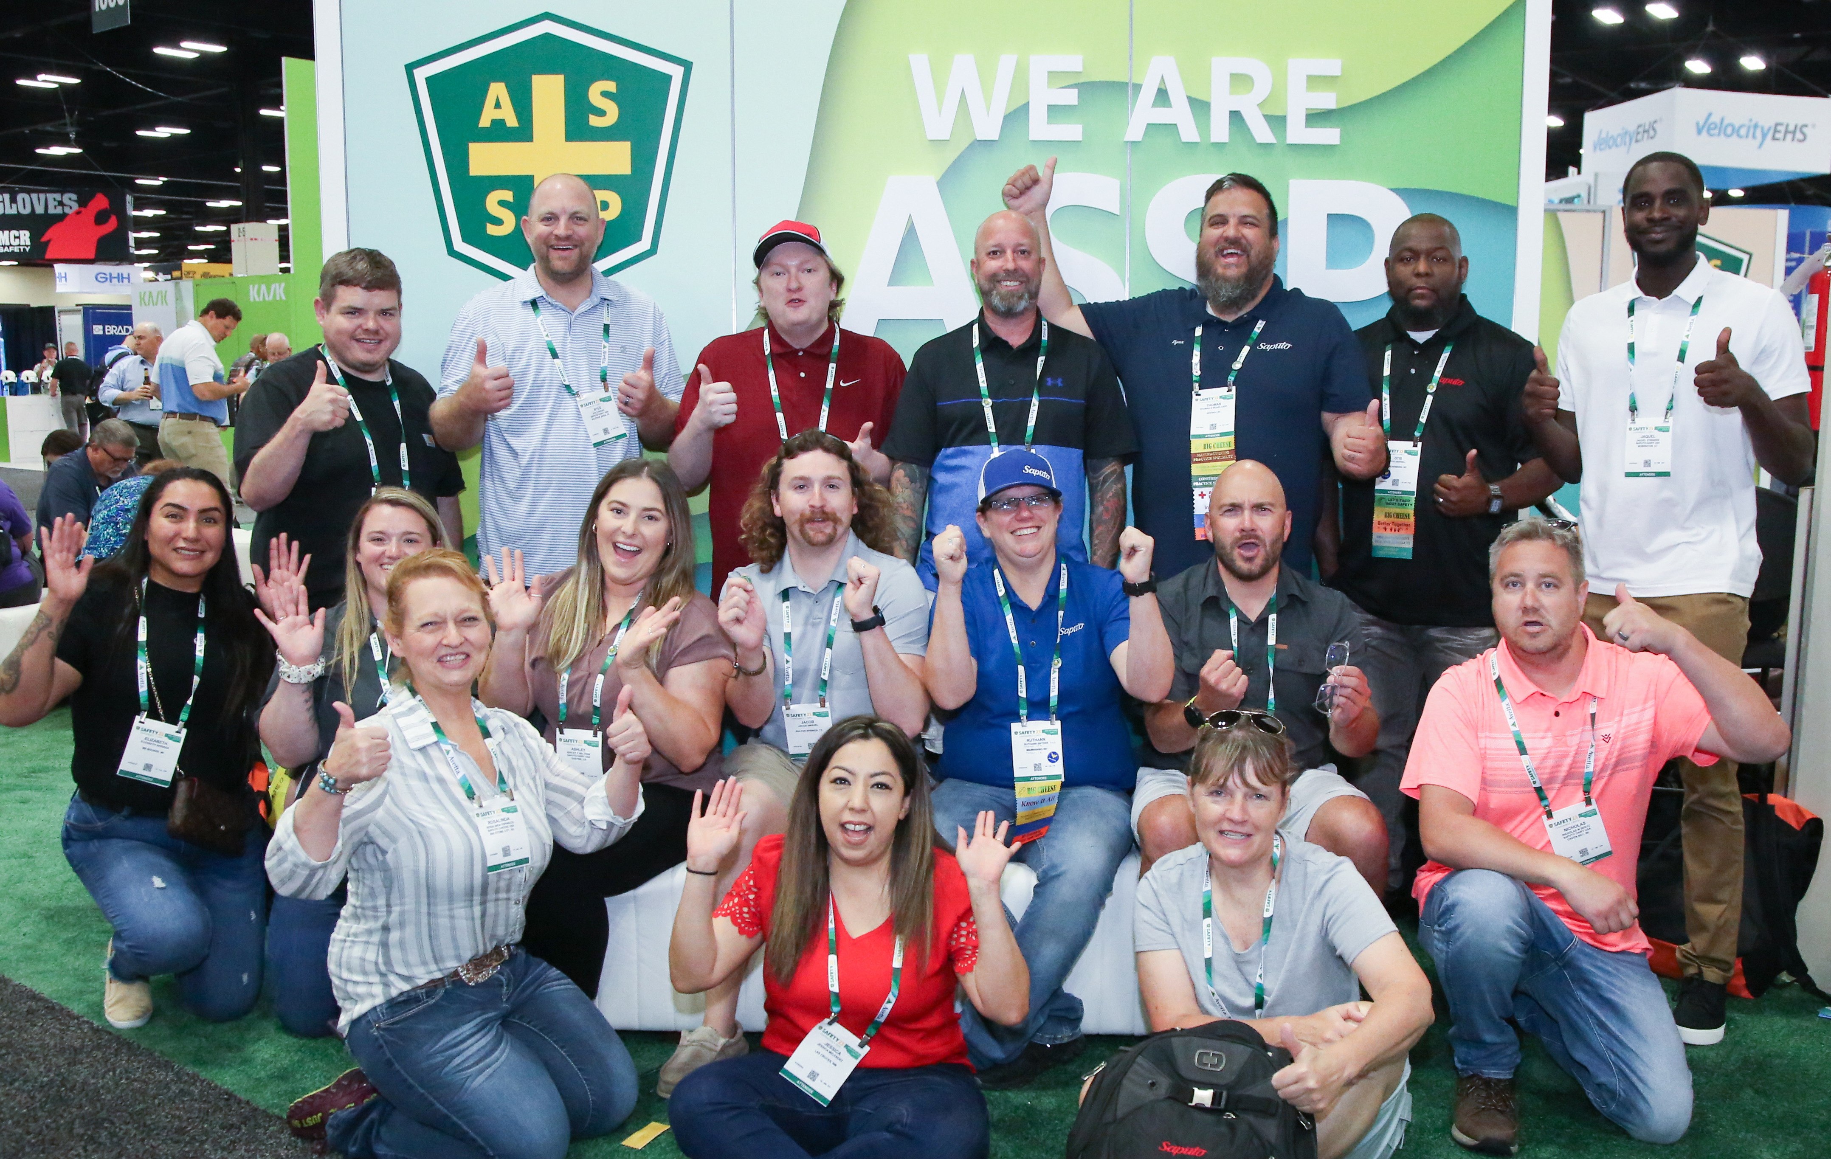
Our CLEAR Values
Community
Leadership
Excellence
Accountability
Respect
Notes:
Living our CLEAR Values
Originally developed several years ago as part of an effort to improve culture within ASSP’s staff structure, we have evolved them to encompass the entire ASSP ecosystem to serve as a compass for interactions across our organization and within our community.
Community: We provide a welcoming and collaborative environment that creates belonging and inclusivity for all.
Leadership: We exemplify integrity and empower others.
Excellence: We strive always to deliver our best .
Accountability: We are ethical, reliable and trustworthy in all we do.
Respect: We act with humility, listen to others and foster strong working relationships.
By adopting the CLEAR values across the Society, we continue to live and enhance our Strengths-based culture, leveraging the best of all of us across our ASSP ecosystem.

Slide 9
Strategic Focus on Three Domains
Member Community
Trusted Advisor
Workforce Development
Notes:
We are focused on three domains where we can generate the greatest impact:
Member Community
Trusted Source
Workforce Development
As a trusted source for technical knowledge and evidence-based safety practices, we provide our diverse community with opportunities to develop relationships and skills that enhance careers and help you influence how organizations demonstrate that they value the safety, health and well-being of all workers.

Slide 10
Member Community
Our Goal
Engage OSH professionals with meaningful experiences that provide lasting value to ensure member retention and support future growth of ASSP, its members and the OSH profession.
Notes:
Member Community
Throughout our long history, we have recognized the critical importance of our member community.
We are committed to providing members with meaningful experiences that not only empower them professionally but also create lasting personal connections.
We aim to foster a vibrant network where OSH professionals can engage, share insights, learn from each other, and contribute to the continued growth and recognition of our profession.
By ensuring that ASSP’s membership experience is enriched with value, we set the stage for the future growth of both ASSP and the OSH profession.
Additional points as needed
We are a community of safety professionals who are dedicated to creating safe work environments by preventing workplace fatalities, injuries and illnesses.
We create opportunities for our diverse community to share their knowledge and passion for workplace safety with each other and with the entire OSH community.
We provide value to our members by providing connection and community across all our virtual and in-person experiences.
We advance leadership development and the growth of individuals within the profession through our community’s generous support of our charitable foundation.

Slide 11
Trusted Advisor
Our Goal
Provide evidence-based guidance to OSH professionals, workers, employers and policy leaders to enhance their efforts to manage risks created by changing work practices and emerging technologies.
Notes:
Trusted Advisor
Provide evidence-based guidance to OSH professionals, workers, employers and policy leaders to enhance their efforts to manage risks created by changing work practices and emerging technologies.
As work practices evolve and technologies advance, new challenges arise in ensuring worker safety, health and well-being. We are dedicated to being a trusted advisor, offering evidence-based guidance that equips OSH professionals, workers, employers and policy leaders with the knowledge and tools to effectively manage emerging risks.
Through research and collaboration, we will endeavor to empower you to make informed decisions that safeguard lives, protect property and preserve the environment.
We are a trusted source among safety professionals for thought leadership, education and objective, evidence-based approaches to safety and health practices.
We provide evidence-based guidance to safety professionals, workers, employers and policy leaders to help them manage risks created by changing work practices and emerging technologies.
We empower and advocate for the OSH profession by demonstrating the value of safety, health and well-being that goes beyond compliance, leveraging best practices and voluntary consensus standards.

Slide 12
Workforce Development
Our Goal
Elevate safety as integral to successful business operations by developing tools and resources for OSH professionals and related fields to meet current needs and anticipate future needs.
Notes:
Workforce Development
Our goal: Elevate safety as integral to successful business operations by developing tools and resources for OSH professionals and related fields to meet current needs and anticipate future needs.
A skilled, competent and adaptable workforce is fundamental in today’s world. We must continue to find new ways to elevate OSH as an indispensable facet of thriving business operations. By developing forward-looking education, tools and resources, we can ensure OSH professionals and allied fields are equipped to meet current and future needs.
Our proactive approach will solidify safety as a cornerstone of successful business operations, ultimately enhancing the well-being of workers and the overall sustainability of our world.
We help our members advance their careers through skill development and career guidance from experts in the safety field.
We support and empower our members to address workplace safety challenges and to influence and guide their organizations beyond compliance.
Through our charitable foundation, we promote OSH as a career choice, and we help build a sustainable talent pipeline for the profession.
Donations to our charitable foundation help us to offer free resources and opportunities for educational assistance to improve access to safety education and career development.

Slide 13
How We Use the Strategic Plan
Board of Directors uses the plan in all decision-making:
Setting priorities
Aligning work of Advisory Group, councils and committees
Determining resource allocation
Guiding decisions on strategic partnerships

Slide 14
How We Measure Progress
Notes:
An updated look at what KPIs help us achieve:
Keep people interested
Create a sense of purpose and give everyone a clear understanding of their roles and their impact.
Keep people informed
Provide relevant, accurate and timely data facilitates informed decisions and goal alignment.
Keep people involved
Provide a framework that allows individuals to contribute actively and understand how their efforts contribute to the organization's success.
Keep people inspired
Motivate stakeholders by showing progress and positive impact of efforts.
As noted earlier, by analyzing results across the spectrum, we can continuously refine alignment between our strategies, tactics and goals.
This ongoing learning process ensures we remain responsive to changes and adjust our approach as needed.

Slide 15
Communications Roll Out
August 2023
June 2023
BOD approves Strategic Plan
October 2023
November – January 2024
Reinforce messaging across communications channels
Discuss plan with volunteer leaders
BOD reviews tactics/KPIs
September 2023
President's Message in PSJ and on website to inform members
Notes:
Our current timeline:
The plan was approved by the Board of Directors in June.
Professional staff has developed key performance indicators to track progress.
High-level details shared with all members in the September 2023 President's Message published in PSJ and on the website.
Support materials for volunteer leaders and staff are being developed to help cascade the plan across the organization.
Other communication tools include ASSP Weekly (distributed), infographic (in process) and Annual Report (coming in October).

Slide 16
Breakout Session

Slide 17
Breakout Session Questions
Reflecting on your ASSP leadership experience, how do you see yourself in our strategic plan?
What story from your safety career can you share with others to communicate the mission and vision of ASSP?
Use the Road Map to your ASSP Story worksheet to kick start this discussion

Slide 18
governance@assp.org

Slide 19
Next Steps
Share the new Strategic Plan with:
Your Council/Region/Area
Your Chapter
Your Practice Specialty/Common Interest Group
Your Safety Peers and Colleagues
Send feedback to the Board
Governance@assp.org
Notes:
Share the Strategic Plan with your constituents.
Share feedback from your constituents with the Board of Directors by emailing thoughts/comments to governance@assp.org The information will be compiled and shared with the BOD at a future meeting.

Slide 20
THANK YOU!

