Slide 1
Engineers Week – Engineers in Safety
Lawrence J. H. Schulze, PhD, PE, CPE
Associate Professor
Director, Process Safety Certificate Program
E206 Engineering Building 2
University of Houston, Houston TX 77204-4008
ljhs@uh.edu, docergo@gmail.com, 713-252-2803

Slide 2
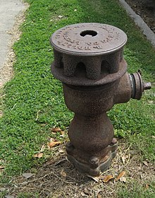
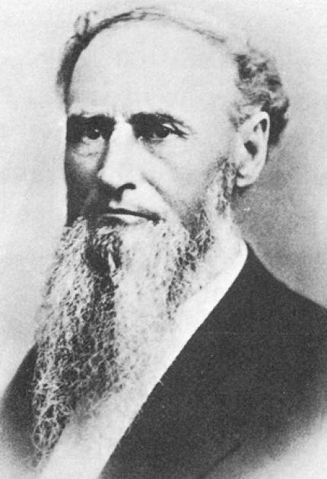
Module 1
Birdsill Holly Jr.
1820-189
ASME.org and Invent.org

Slide 3
Engineering Practice Specialty – Come Join Us
Safety Engineer Practice Specialty | ASSP

